Slide 1
COM object
Interface
IUnknow Interface
Reference Counting
server

Slide 2
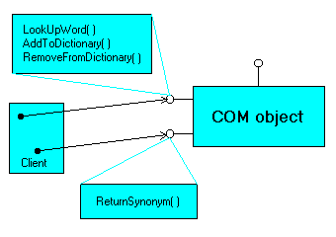
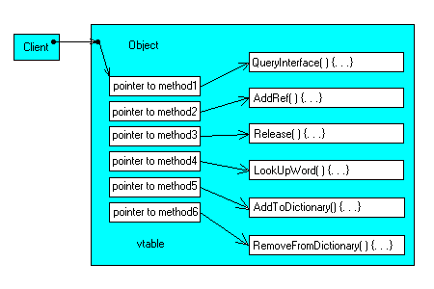
Interface
IUnknown Interface

Slide 3
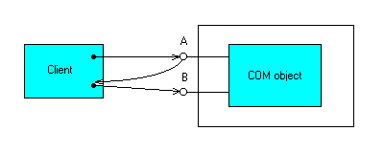
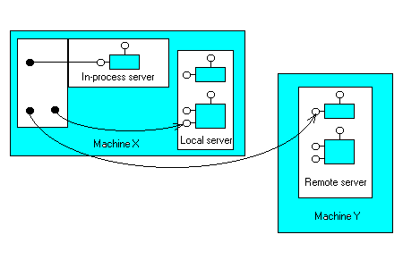
IUnknown:: QueryInterface
Server

Slide 4
DCOM
การสร้าง Remote object
CoCreateInstanceEx
CoGetInstanceFromFile
CoGetInstanceFromIStorage
OXID
pinging
security

Slide 5
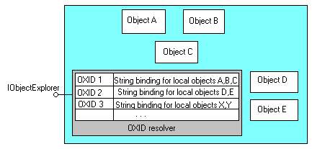
OXID

Slide 6
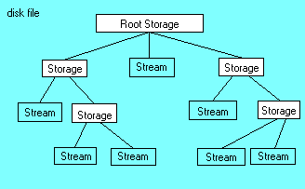
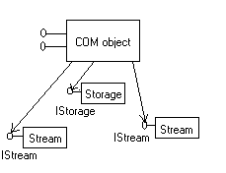
Persistence
IPersist*
- IPersistStream
- IPersistStorage
- IPersistFile

Slide 7

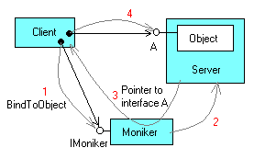
Moniker
CLSID
Filename

Slide 8
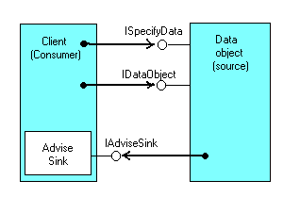
Notification
DAdvise
DUnadvise
OnDataChange

Slide 9
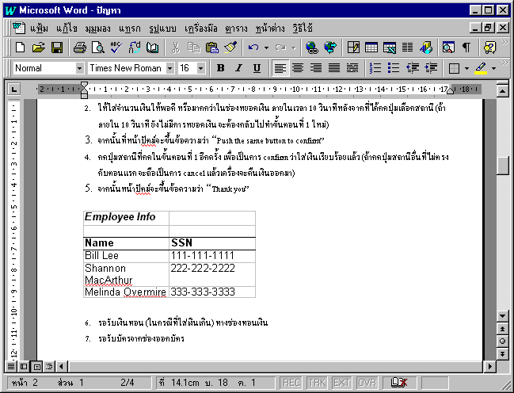
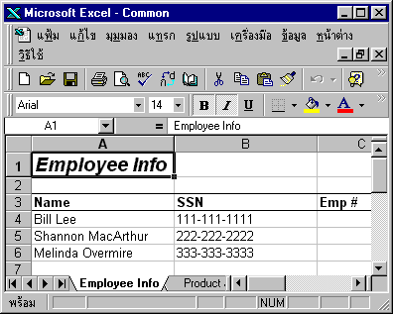
Compound Document (OLE Document)

Slide 10
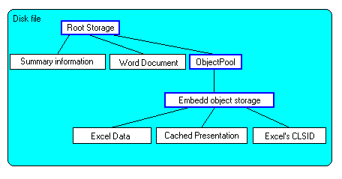
OLE Embedded Document

Slide 11
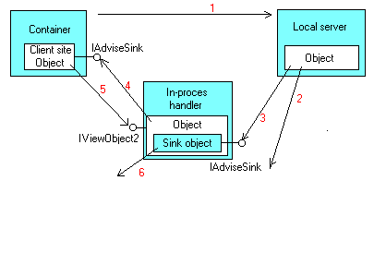
Embeded Document ทำงานอย่างไร

Slide 12
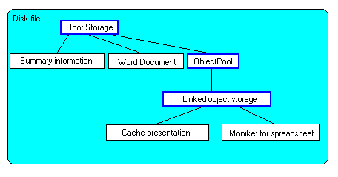
OLE Linked Document
- Manually Update
- Automatically Update

Slide 13
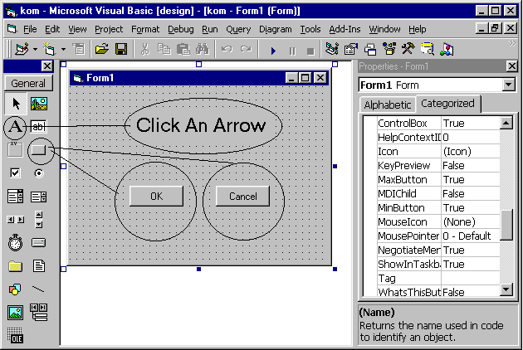
ActiveX Control

Slide 14
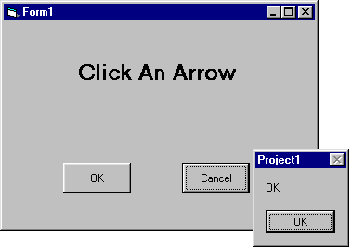
การกำหนดการทำงานให้กับ Control
Sub Button_OK( )
MsgBox (“Up arrow clicked”)
End Sub

Slide 15

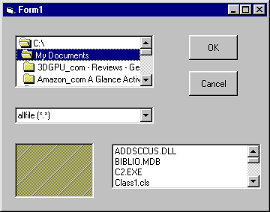

2
1
event
3

